Slide 1
CKME136 Capstone Presentation
TalkingData AdTracking Fraud Detection Challenge
https://github.com/PHLHY/Capstone
Phi Huynh
500777278
Monday, April 8, 2019

Slide 2
Kaggle Competition
Kaggle competition started on March 8, 2019 and ended on May 5, 2019
Prize money:
1st Place - $12,500
2nd Place - $7,500
3rd Place - $5,000
Competition found on this link: https://www.kaggle.com/c/talkingdata-adtracking-fraud-detection/overview

Slide 3
Research Question
TalkingData provided a dataset of around 200 million clicks spanning over 4 days for a Kaggle challenge with the aim of building an algorithm for determination of users that will download a mobile application after clicking on a relevant advertisement
As per the competition, evaluation is based on the area under the ROC curve with a submission file using the attributes, “click_id” and “is_attributed” from the testing set
Techniques for classification analysis will be employed on the R platform (RStudio) to tackle this challenge

Slide 4
TalkingData Datasets
Training and testing datasets are provided by TalkingData. The training set includes 184903890 data points with 8 attributes while the testing set includes 18790469 data points with 7 attributes
A direct copy of the description of the attributes was provided by Talking data and can be found from this link: https://www.kaggle.com/c/talkingdata-adtracking-fraud-detection/data
ip: ip address of click.
app: app id for marketing.
device: device type id of user mobile phone (e.g., iphone 6 plus, iphone 7, huawei mate 7, etc.)
os: os version id of user mobile phone
channel: channel id of mobile ad publisher
click_time: timestamp of click (UTC)
attributed_time: if user download the app for after clicking an ad, this is the time of the app download
is_attributed: the target that is to be predicted, indicating the app was downloaded
The test data is similar, with the following differences:
click_id: reference for making predictions
is_attributed: not included

Slide 5
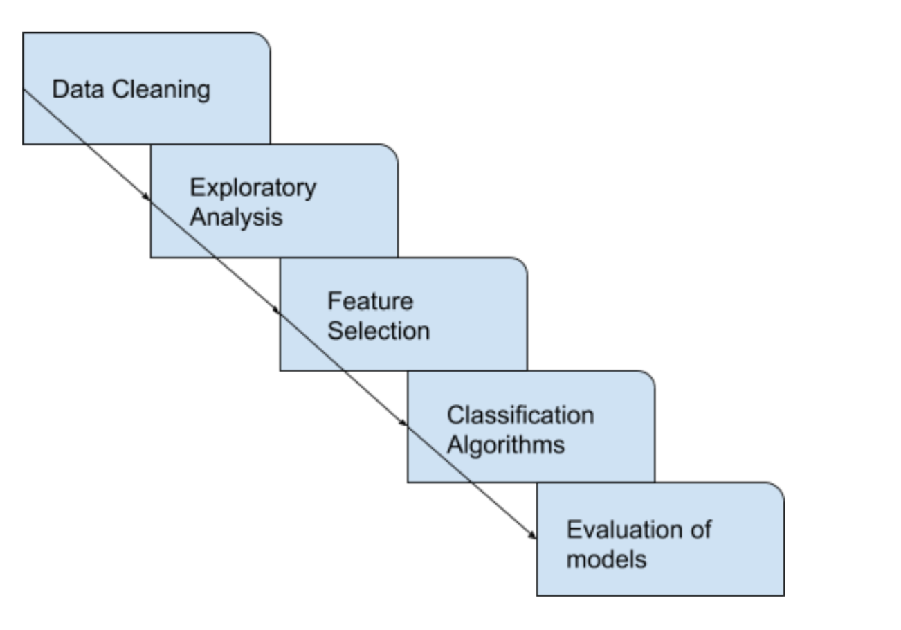
Approach

Slide 6
Data Cleaning
No missing values
Data was reduced into 25000 observations
Target attribute, “is_attributed” converted to categorical data type
The attribute, “click_time” was split into data and time format
Redundancy in “attributed_time” and “is_attributed”
Notes:
Example is ip attribute in now reduced set (still has 15046 unique IP addresses)

Slide 7
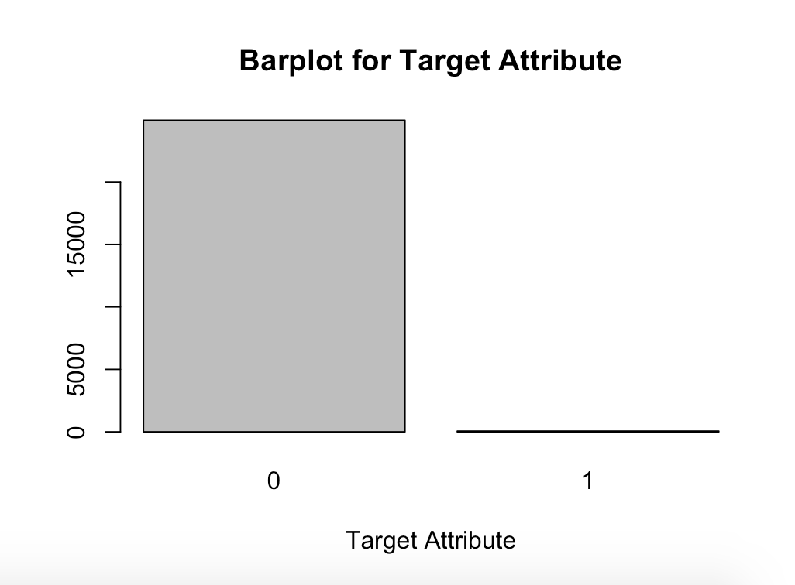
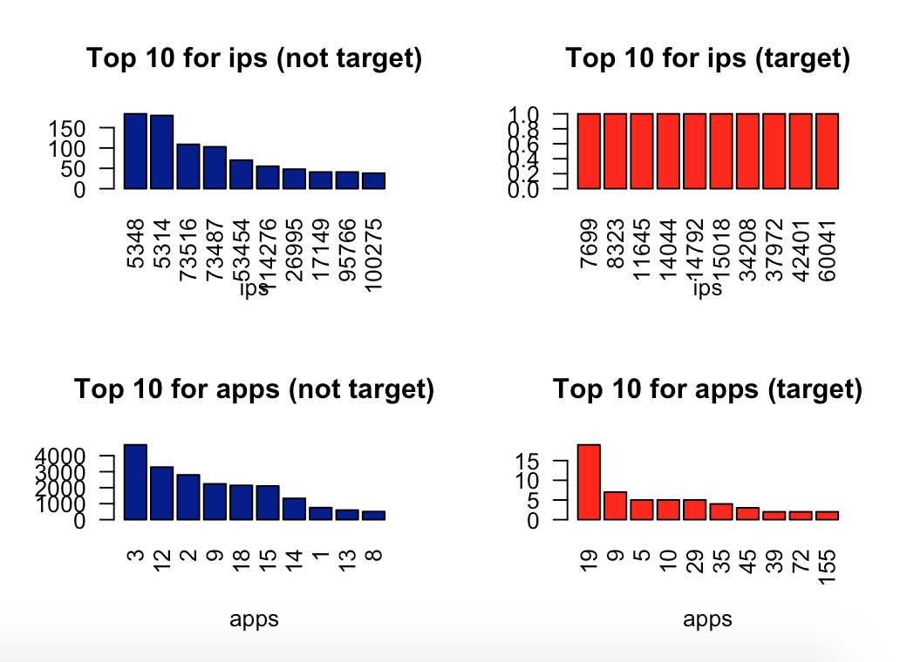
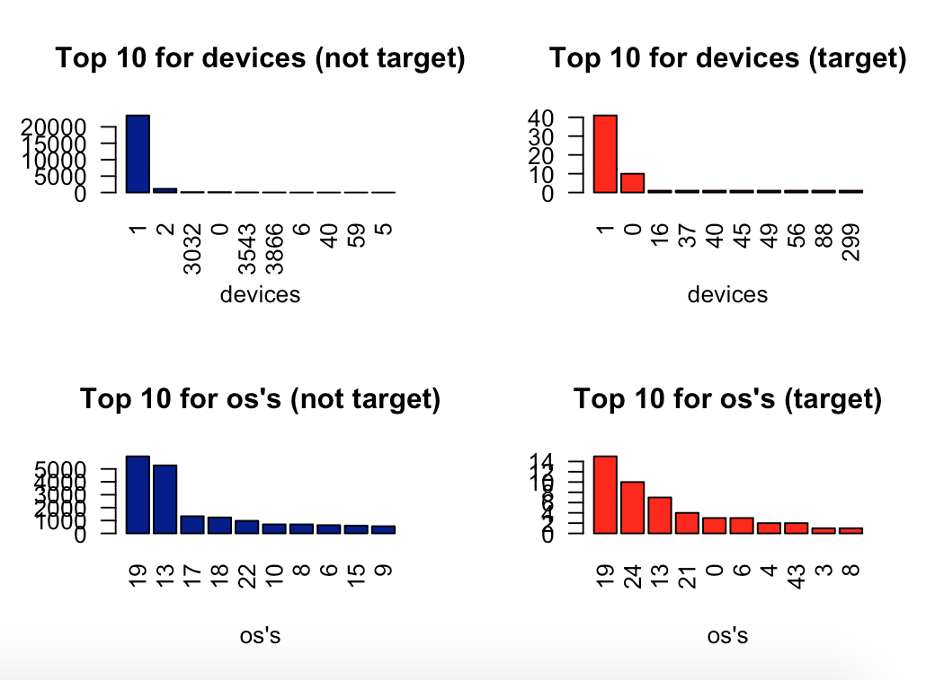
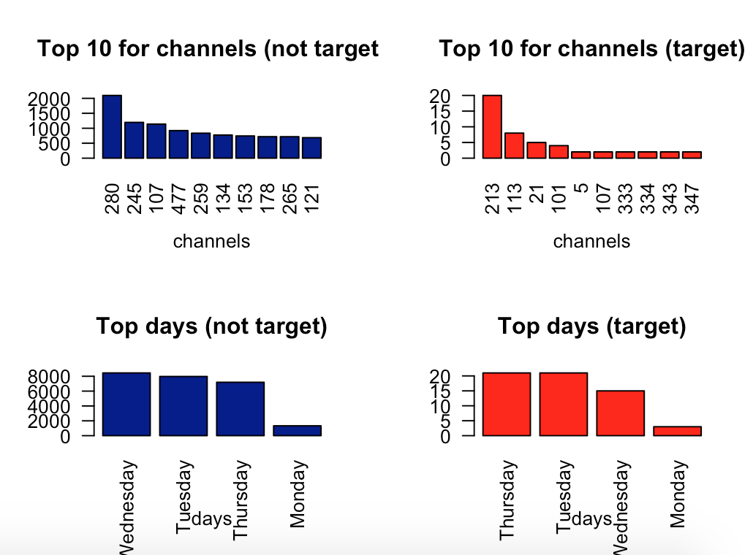
Exploratory Analysis

Slide 8
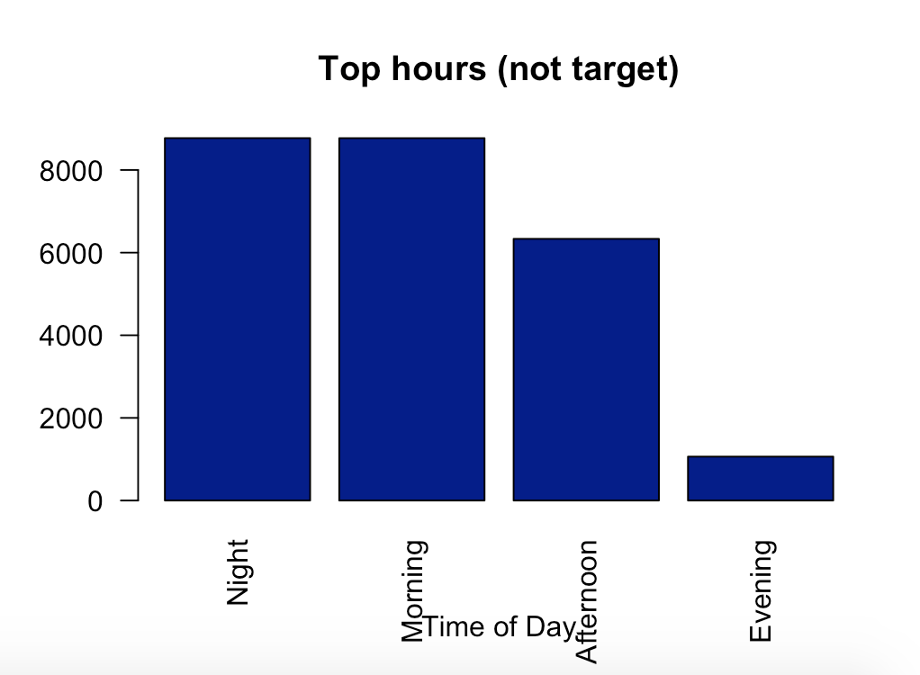
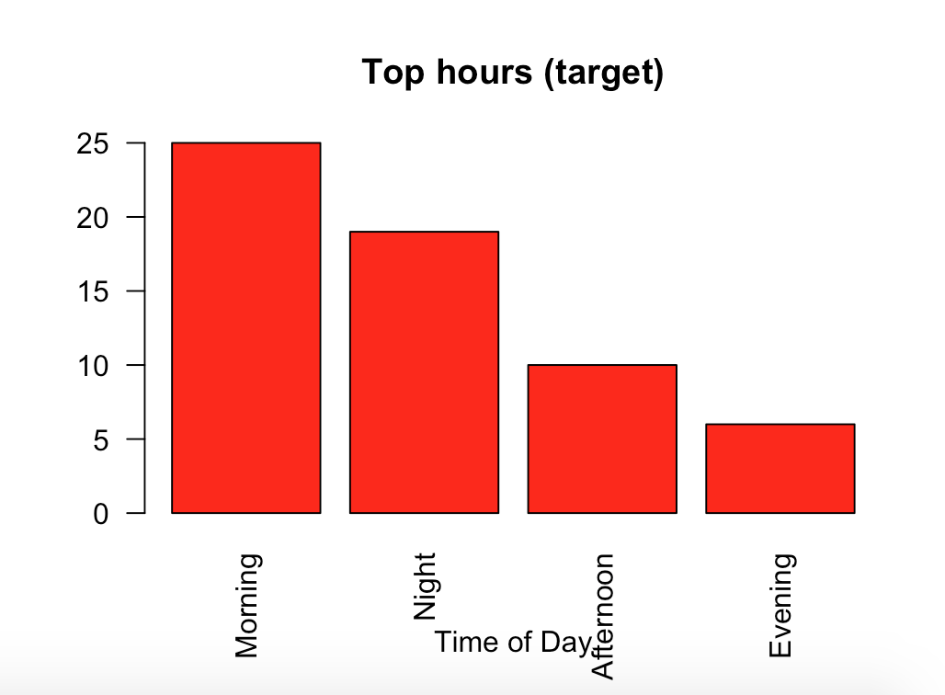
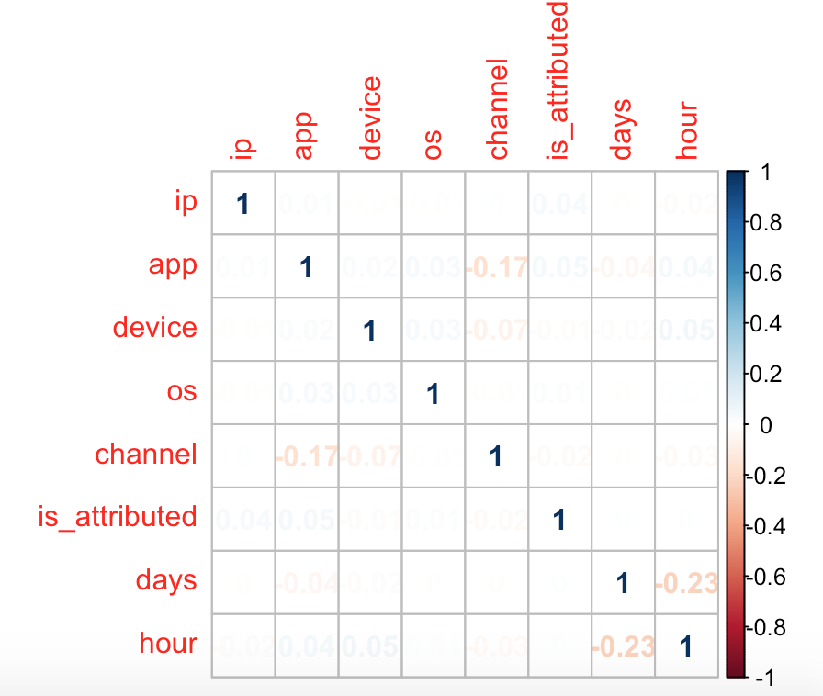
Exploratory Analysis (cont.)

Slide 9
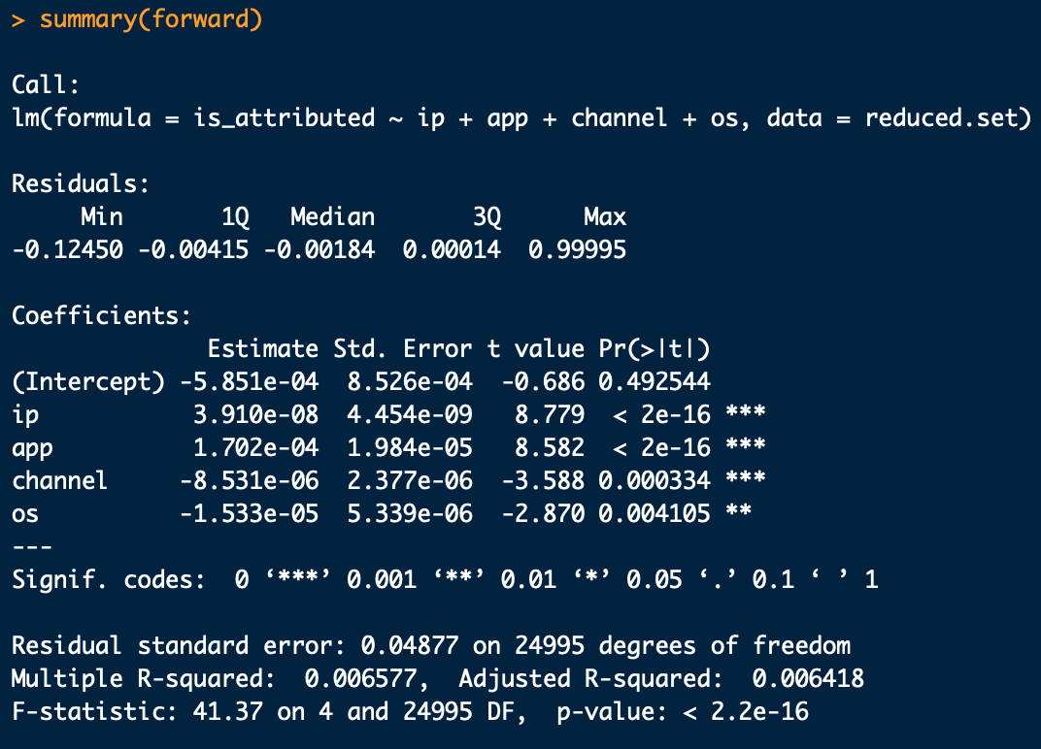
Feature Selection
StepAIC - Forward direction
The follow attributes will be carried forward for the modelling process: “ip”, “app”, channel”, “os”, and with our target attribute, “is_attributed”

Slide 10
Algorithms and Balancing Methods
Reduced set (25000 observations) split into testing set (70%) and validation set (30%)
Repeated cross validation done (5 folds and 3 repeats)
Constant seed set for all models in regard to the folds and resampling process for comparison of models
6 models produced based on combination of classification algorithms and balancing methods
Algorithms/Balancing | None | SMOTE | Upsampling
RandomForest | - | - | -
XGBoost | - | - | -

Slide 11
Evaluations of the Models
Confusion matrix statistics - Accuracy, sensitivity, specificity, precision, recall, and F1 score
Area Under the Curve (AUC) based on the Receiver Operating Characteristic (ROC) curve
Statistical significance - constant folds and resampling processes, paired T-tests, bonferroni correction

Slide 12
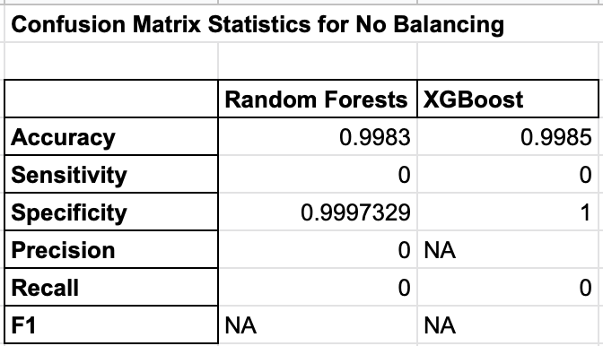
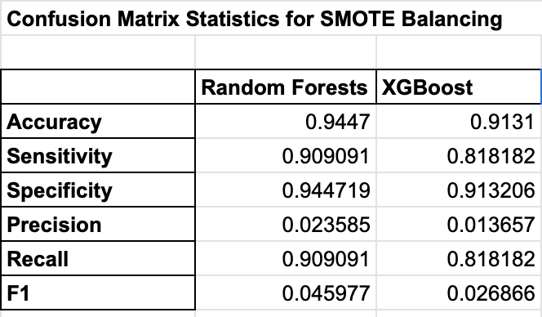
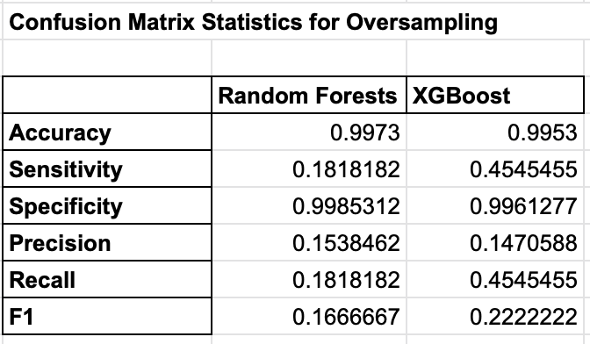
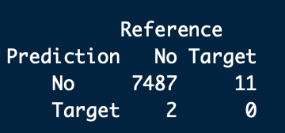
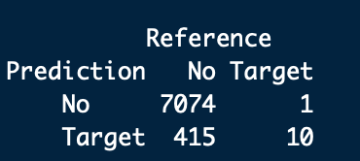
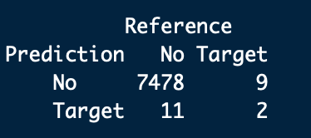
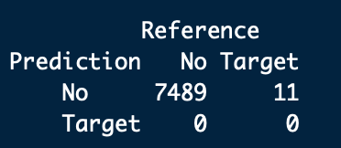
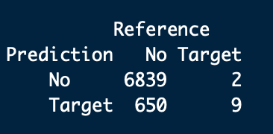
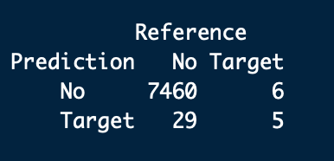
Results - Confusion Matrix Statistics
Notes:
TN - FN
FP - TP
Type 1 error - False positive (SMOTE)
Type 2 error - False negative (No balancing)
Accuracy: Correct prediction/all
TPR/Recall/Sensitivity: Proportion of those that is actually positive is captured by the algorithm (TP/TP + FN)
Specificity: Opposite of recall where it looks at the actual negative being captured by the algorithm, (TN/TN+FP) - not as important in this scenario || 1-Specificity (FPR)
Precision: Actually correct over all of the positives (TP/TP + FP) - Research articles wants this
F1: Harmonic mean between recall and precision

Slide 13
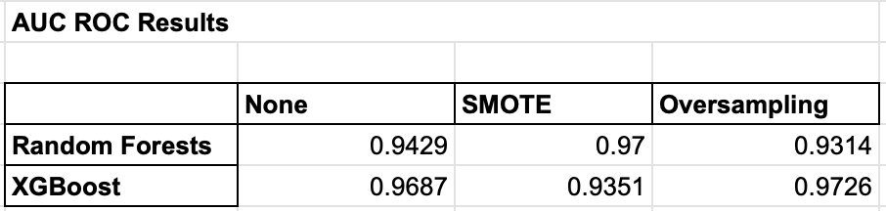
Results - AUC ROC
Notes:
ROC - probability curve, AUC - measure of separability
Distinguishing between classes, higher AUC score is better
TPR vs. FPR, threshold of varying sensitivity and specificity

Slide 14
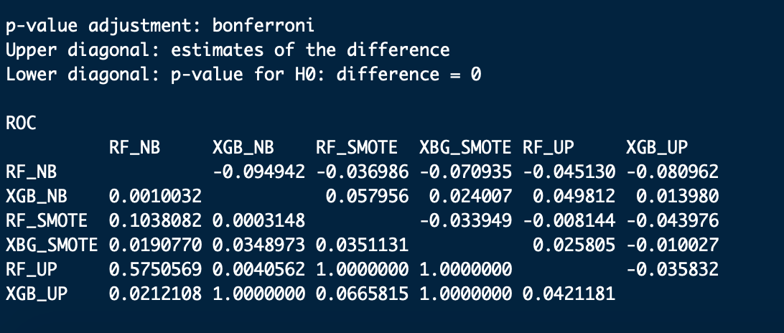
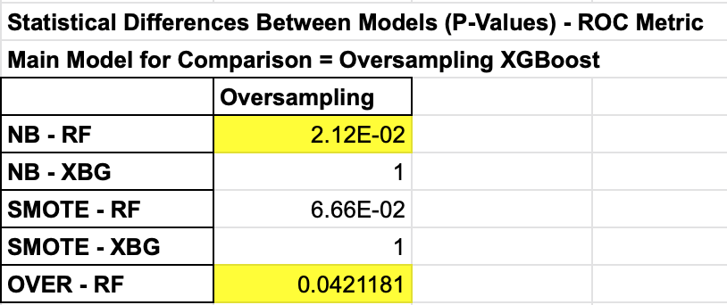
Results - Statistical Significance on the ROC
Main comparison model - Upsampling XGBoost algorithm
Noted to be statistically different to two other models (Unbalanced RandomForest and Upsampling RandomForest)

Slide 15
Conclusion
Main method of evaluation for this competition was the area under the ROC curve
Thus, upsampling XGBoost model will be the choice selection for this Kaggle challenge
Based on the highest AUC - ROC score and is significantly different compared to two other models
In addition, with consideration of the statistics from the confusion matrix, this model has the second highest precision score and F1 score

Slide 16
Limitations and Future Considerations
Computational limitations
● Dataset was reduced significantly to only 25000 points for training and testing
● Some of the attributes were not converted to categorical data type
Further exploratory analysis and feature engineering
● “Attributed_time” for feature engineered
● Potentially all attributes could have been included in the models for benchmarking
Modelling
● Preprocessing was not done
● Could have considered different types of balancing (ie. ROSE, undersampling etc.)

